Slide 1
Using Current Evidence Based Resources to Reach Well-Informed Shared Decision-Making
Sheila Bond, MD, FACP
Harvard Medical School
September 2 , 2016

Slide 2
What is Shared Decision Making?
Collaborative process that facilitates patients and their providers making health care decisions together
Best clinical evidence available + patient values and preferences
Notes:
Shared decision making brings at least two experts to the table, the patient and the provider, although family members and other members of the care team may be involved. The provider is an expert in the clinical evidence. Patients are experts in their experiences and what matters most to them.

Slide 3
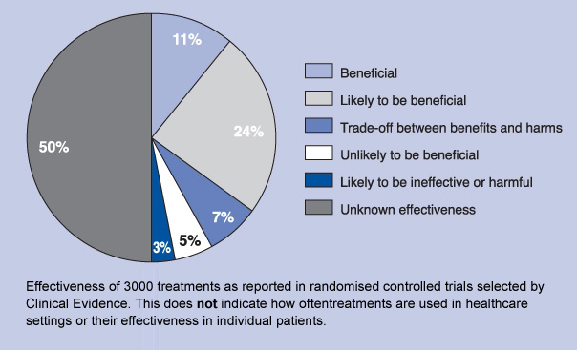
When can SDM be used?
For any health decision that has > 1 medically reasonable option
For 86% of treatments no clear best choice
BMJ Clinical Evidence.
Notes:
For example, over 3000 healthcare treatments have been classified as: 11% beneficial, 24% probably beneficial, 7% need to weigh known benefits versus risks, 5% probably not beneficial, 3% likely to be ineffective or harmful, and50
Hence, for 86% of these treatments there is no clear best choice. % insufficient evidence of usefulness.⁵

Slide 4
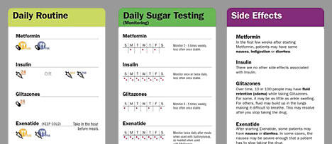
What tools can help with SDM?
Patient Decision Aids (PDAs)
Tools that help patients participate in decision making by providing information about the options and outcomes and by clarifying personal values
Notes:
do not replace discussion in the consultation.

Slide 5
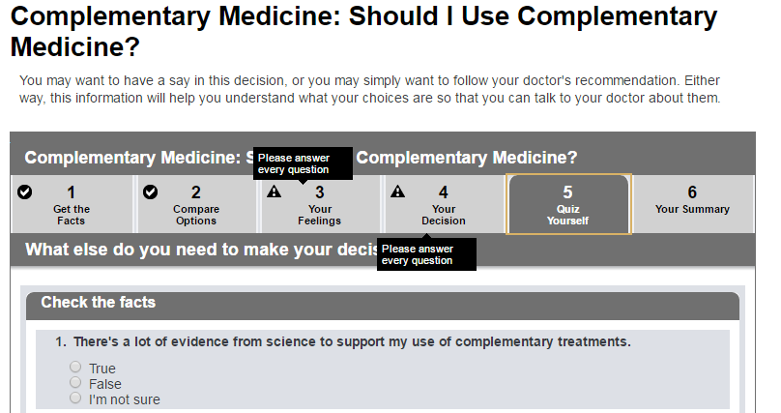
What tools can help with SDM?
Patient Decision Aids (PDAs): Worksheets
Tools that help patients participate in decision making by providing information about the options and outcomes and by clarifying personal values
Notes:
do not replace discussion in the consultation.

Slide 6
What tools can help with SDM?
Patient Decision Aids (PDAs): Worksheets
Tools that help patients participate in decision making by providing information about the options and outcomes and by clarifying personal values
Notes:
do not replace discussion in the consultation.

Slide 7
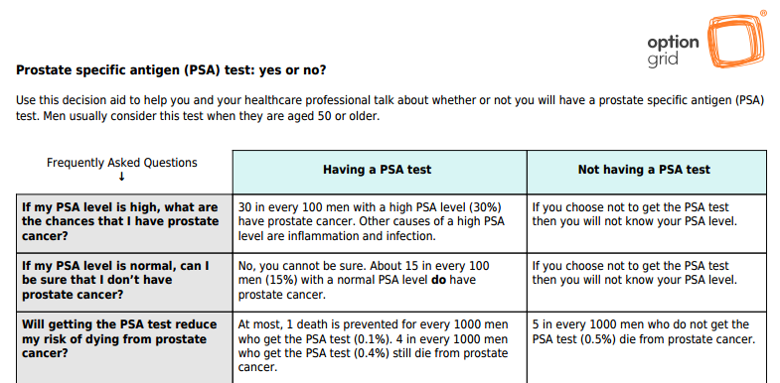
What tools can help with SDM?
Patient Decision Aids (PDAs): Option Grids
Tools that help patients participate in decision making by providing information about the options and outcomes and by clarifying personal values
Notes:
do not replace discussion in the consultation.

Slide 8
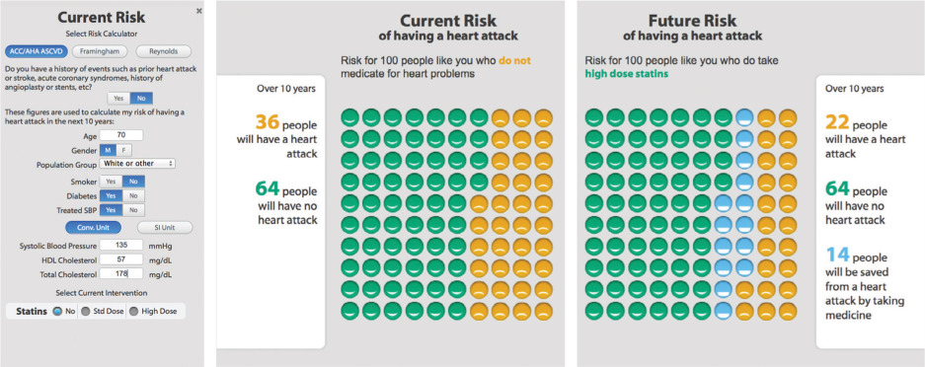
What tools can help with SDM?
Patient Decision Aids (PDAs): Interactive Tools
Tools that help patients participate in decision making by providing information about the options and outcomes and by clarifying personal values
Notes:
do not replace discussion in the consultation.

Slide 9
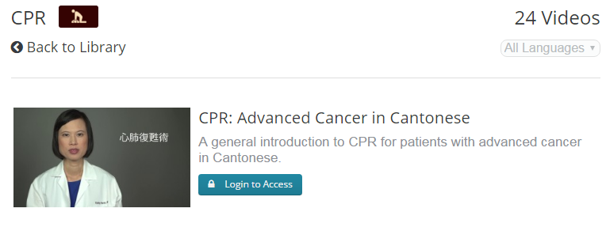
What tools can help with SDM?
Patient Decision Aids (PDAs): Videos
Tools that help patients participate in decision making by providing information about the options and outcomes and by clarifying personal values
Notes:
do not replace discussion in the consultation.

Slide 10
Do PDAs help patients make decisions?
A systematic review of > 100 randomized controlled trials including >30,000 patients showed that patient decision aids are better than usual care
Compared to usual care, decision aids
Increase knowledge
measured as % correct responses about information in decision aid
mean difference [MD] 13%, 95% CI 10%-16% in analysis of 19 trials with 6,865 patients
Decrease decisional conflict
based on decisional conflict on Decisional Conflict Scale
mean difference -6.83, 95% CI -12.64 to -1.03) in analysis of 6 trials with 2,047 patients
Help the undecided patient make a decision
risk ratio (RR) 0.52 (95% CI 0.3-0.9)
NNT 7-46 with 22% undecided in control group in analysis of 4 trials with 1,923 patients
most common decisions assessed were for prostate cancer screening (15 trials), colon cancer screening (15 trials), menopausal hormone therapy (10 trials), breast cancer genetic testing (7 trials), and prenatal screening (6 trials)
Reference - Cochrane Database Syst Rev 2015Apr;(4):CD001431
.

Slide 11
What specific PDA components are helpful?
Description of outcome probabilities
associated with higher likelihood of accurate risk perception (perceived probabilities of outcomes) in analysis of 7 trials with 3,433 patients
RR 2.03 (95% CI 1.4-2.93)
NNT 2-9 with accurate risk perception in 28% of control group
Specific exercises to clarify patient values
associated with increased likelihood of chosen option congruent with patient values in analysis of 10 trials with 4,321 patients
RR 1.56 (95% CI 1.16-2.11)
NNT 3-21 with chosen option congruent with patient values in 30% of control group
Reference - Cochrane Database Syst Rev 2015Apr;(4):CD001431
.

Slide 12
International Patient Decision Aids Standards (IPDAS)
Requirements
Recommended Options
Present probabilities of outcomes tailored to the patient's health risk factors
Provide patient stories
Provide guidance in the steps of decision making and communicating with others
Summarize findings to share with the health professionals
Make explicit the decision
Provide information on the disease/condition, options, benefits, harms, scientific uncertainties
Clarify values by describing outcomes and/or asking the patient to rate the importance of benefits and harms

Slide 13
Helpful resources for decision aids
The Ottawa Hospital
Ottawa Personal Decision Guide
A to Z Inventory of Decision Aids
The Mayo Clinic
Statin Choice Calculator
Osteoporosis Calculator
Dartmouth University
Options Grids
Advanced Care Planning Decisions
Videos
Evidence
Notes:
Have users view the tool here

Slide 14
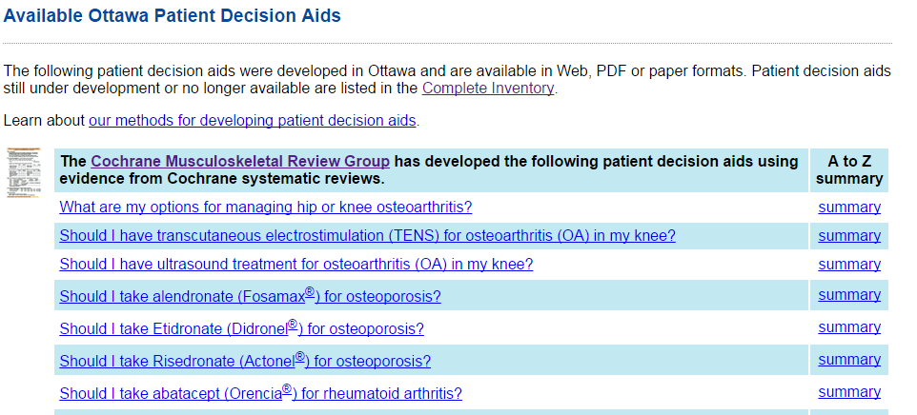
The Ottawa Hospital https://decisionaid.ohri.ca/decaids.html

Slide 15
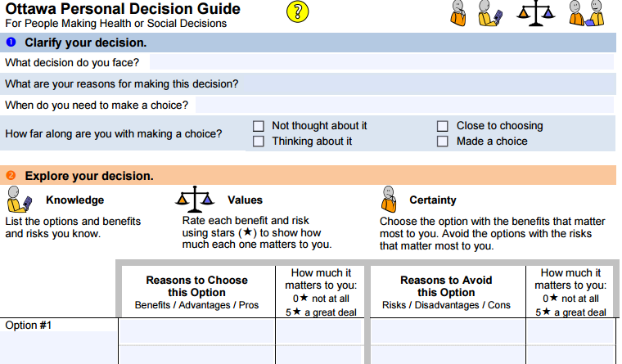
The Ottawa Hospital https://decisionaid.ohri.ca/decaids.html

Slide 16
The Ottawa Hospital https://decisionaid.ohri.ca/decaids.html
Notes:
describe the procedures and outcomes to help patients imagine what it is like to experience their physical, emotional, social effects 4.1Yes ask patients to consider which positive and negative features matter most 4.2Yes suggest ways for patients to share what matters most with others 4.3

Slide 17
The Mayo Clinic http://shareddecisions.mayoclinic.org/

Slide 18
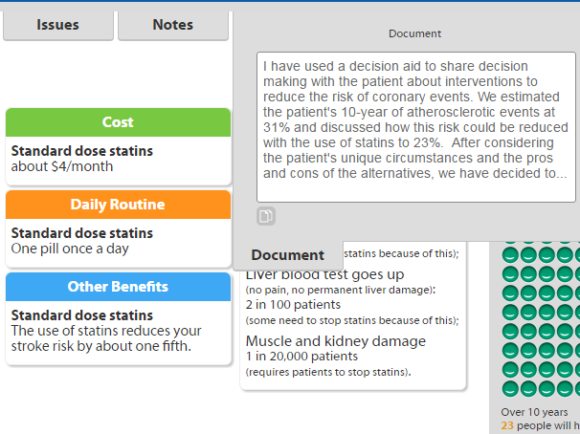
The Mayo Clinic http://shareddecisions.mayoclinic.org/
Notes:
"As doctors we tend to often use words like, 'very small risk,' 'very unlikely,' 'very rare,' 'very likely,' 'high risk,' " she says.
But those words can be unclear to a patient.
"People may hear 'small risk,' and what they hear is very different from what I've got in my mind," she says. "Or what's a very small risk to me, it's a very big deal to you if it's happened to a family member."

Slide 19
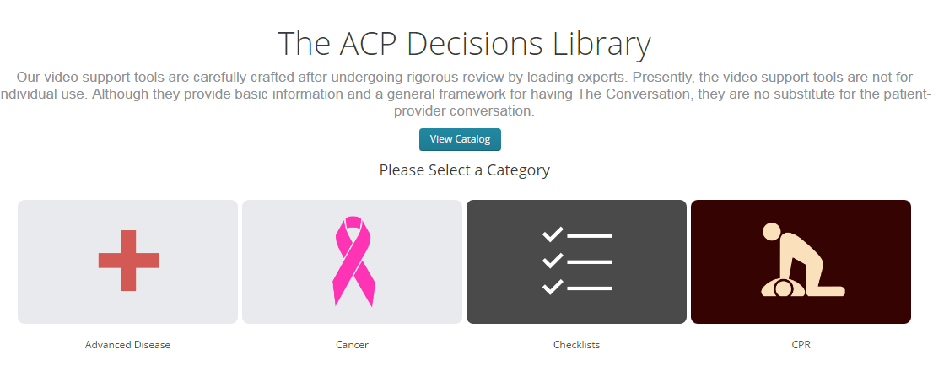
Advanced Care Planning http://www.acpdecisions.org/
Notes:
Outpatient Oncology Care
A social worker met with a patient, her husband, and her adult daughter to watch an ACP Decisions video during an outpatient chemotherapy appointment. The patient had been recently hospitalized and was decreasingly able to care for herself. The video was shown in Ilocano, her native language, even though the family is bilingual. Immediately after viewing the video they were able to start having a discussion about the patient’s goals of care.

Slide 20
Advanced Care Planning Decisions

Slide 21
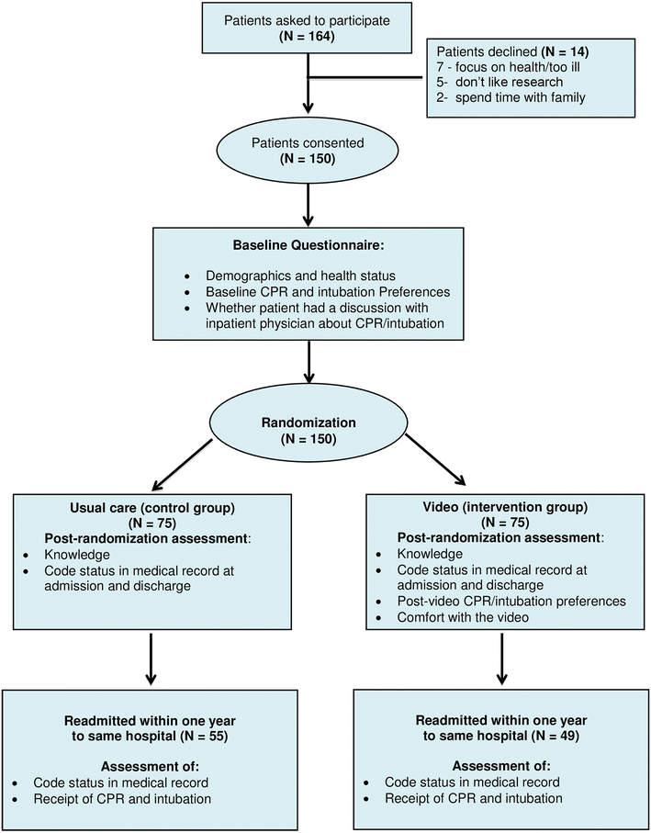
ACP videos studied in RCTs
Journal of General Internal Medicine
August 2015, Volume 30, Issue 8, pp 1071–1080

Slide 22
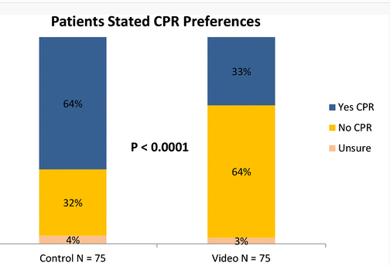

Slide 23
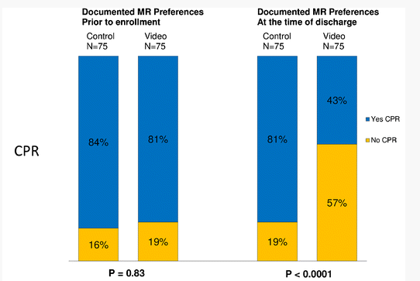

Slide 24
Knowledge

Slide 25
Do you have any experience with SDM or PDAs?
Successes?
Challenges?
Unknowns?
Notes:
Have users view the tool here

Slide 26
Questions?

Slide 27
DynaMed Plus’ story in PDA development
Best clinical evidence available + patient values and preferences

Slide 28
What is DynaMed Plus?
DynaMed Plus is a evidence-based medicine point-of-care tool designed to provide the busy physician with the information they need with a focus on rapid time-to-answer
Notes:
Mention:
Completely redesigned platform based on customer feedback and market research
Responded to market desire for Overviews and Recommendations
New search system and other features (last bullet) -- ALL Focused on time to answer across the entire product

Slide 29
The DynaMed Plus Mission
To provide the most useful information to healthcare professionals
at the point-of-care
Brian Alper, MD
Founder, DynaMed

Slide 30
Live Demonstration

Slide 31
What are DMP’s key features
Guidance for clinicians on how to evaluate and treat patients
Recommendations that are based on most recent evidence and clinical practice guidelines
Systematic curation and critical appraisal of the medical literature at the point of care
Easy to find information with ease of access to primary sources
Growing network of experts and specialists
Editorial Process and Team that exemplifies EBM
Notes:
Mention:
Completely redesigned platform based on customer feedback and market research
Responded to market desire for Overviews and Recommendations
New search system and other features (last bullet) -- ALL Focused on time to answer across the entire product

Slide 32
DynaMed Plus content
> 4500 Clinical topics
> 2000 topics on diseases commonly encountered at the point of care
> 1100 topics with Overviews and Recommendations section
~100 produced in collaboration with American College of Physicians
>100,000 concise evidence summaries
> 1900 drug topics with content supported by MicroMedex
> 600 laboratory topics
> 17,000 clinical practice guideline listings organized by clinical topic and geographic region, with key recommendations incorporated directly into DynaMed Plus content
Streamlined access to additional relevant information sources such as patient information, full text and PDF links directly to original literature and quality improvement information
Notes:
Mention:
Completely redesigned platform based on customer feedback and market research
Responded to market desire for Overviews and Recommendations
New search system and other features (last bullet) -- ALL Focused on time to answer across the entire product

Slide 33
DynaMed Plus’ New Editorial Process
1. Formulating clinical questions - network of experts, specialists and general practitioners
2. Comprehensive literature search and evidence selection - evaluation of relevance and validity by editorial staff
3. Topic development - study summary, critical appraisal and level of evidence
4. Internal methodologic review - review of relevance and validity by a second editorial member
5. Internal clinical review - topic review by a physician editor
6. Content expert review - topic review by more experts or specialists; draft DynaMed’s Overview and Recommendations
7. Recommendations review – review of Overview and Recommendations by DynaMed Recommendations Editors
8. Final review - topic review for publication by a DynaMed Deputy Editor
9. Daily updating - daily systematic surveillance of > 500 medical journals, guidelines and other venues

Slide 34
DynaMed Plus Change in Editorial Process for PDA development
1. Formulating clinical questions - network of experts and patients
2. Comprehensive literature search and evidence selection - evaluation of relevance and validity by editorial staff
3. Topic development - study summary, critical appraisal and level of evidence
4. Internal methodologic review - review of relevance and validity by a second editorial member
5. Internal clinical review - topic review by a physician editor
6. Content expert review - topic review by more experts or specialists, including consumer health language expert
7. Recommendations review – review of Overview and Recommendations by DynaMed Recommendations Editors
8. Final review - topic review for publication by a DynaMed Deputy Editor
9. Updating in response to patient feedback

Slide 35
Questions?

Slide 36
Link to Option Grid

Slide 38
Discussion

Slide 39
Thank you!

Slide 40
We are always looking for:
International Editors
Project Partners
Please feel to reach out: sbond@ebsco.com

Slide 41
The DynaMed Plus Editorial Leadership
5 Editors are full-time employees of DynaMed. Each oversees a publishing group and are responsible for all content published within that group:
Peter Oettgen, MD, FACC, Editor-in-Chief, Cardiology, Pulmonary & Critical Care
Alan Ehrlich, MD, Executive Editor, General Medicine
Sheila Bond, MD, Senior Deputy Editor of Infectious Disease, Immunology & Rheumatology
Kevin Loughlin, MD, MBA, Deputy Editor of Oncology
William Aird, MD, Deputy Editor of Hematology, Endocrinology and Nephrology
All Executive or Deputy editors spend a portion of their time in patient care and/or research and teaching at academic medical centers.
They are supported by an internal team of associate physician editors, biostatisticians, epidemiologists and PhD geneticists, molecular biologists and library scientists each trained in DynaMed’s evidence based approach to critical appraisal of the medical literature, as well as informatics support to systemically survey the medical literature on a daily basis.
The internal team is also works with a rapidly, growing network of hundreds practicing clinicians, clinical content experts and methodologists.

Slide 42
The DynaMed Editorial Staff
Five Recommendations Editors are independent contractors, chosen for their expertise evidence-based medicine, methodology and guideline development:
Amir Qaseem, MD, PhD, MHA, FACP
Esther van Zuuren, MD
Zybs Federowicz, BDS, LDS, RDS
Alan Shaugnnessy, PharmD, MMedEd
Edward Lang, MDCM, CFPC
All Recommendations editors spend a portion of their time in patient care and/or research and teaching at academic medical centers.

